Slide 1
Standardizing RPAL AST’s
Programming Languages
Lecture 6
Adeesha Wijayasiri

Slide 2
The Semantics of RPAL
We use the operational approach:
To specify the semantics of a language, we give an OPERATIONAL PROCESS.
PL constructs are “denoted” with functions whose behavior specify the meaning of the program.

Slide 3
The RPAL Operational Specification
In the case of RPAL, the process is
Scan and parse the program, transduce to a tree.
Standardize the tree.

Slide 4
The RPAL Operational Specification (cont’d)
Flatten the tree into either:
A lambda expression.
Control Structures for a machine (more later)
Important:
RPAL = lambda-calculus + syntactic sugar

Slide 5
Standardizing an RPAL AST
"Desugar" the tree.
Transform into a binary tree, whose internal nodes are exclusively 'gamma' and 'lambda'.

Slide 6
Standardizing 'let' and 'where'
See example
let gamma where
/ \ / \ / \
= P => lambda E <= P =
/ \ / \ / \
X E X P X E

Slide 8
Standardizing 'fcn_form'
See example
fcn_form =
/ | \ / \
P V+ E => P +lambda
/ \
V .E
V+ means "one or more", to be repeated likewise on right side.
The 'dot' indicates the location of the pattern's repetition.

Slide 10
Standardizing Tuples
See example
tau => ++gamma
| / \
E++ gamma E
/ \
aug .nil
E++ means “two or more” E’s.

Slide 12
Standardizing Multi-Parameter Functions
See example
lambda => ++lambda
/ \ / \
V++ E V .E

Slide 14
Standardizing the 'within'
See example
within => =
/ \ / \
= = X2 gamma
/ \ / \ / \
X1 E1 X2 E2 lambda E1
/ \
X1 E2

Slide 16
Standardizing Unary and Binary Operators
See example
Uop => gamma
| / \
E Uop E
Op => gamma
/ \ / \
E1 E2 gamma E2
/ \
Op E1
Uop in [not, neg]
Op in [aug, or, &, +, -, /, **, gr, ...]

Slide 17
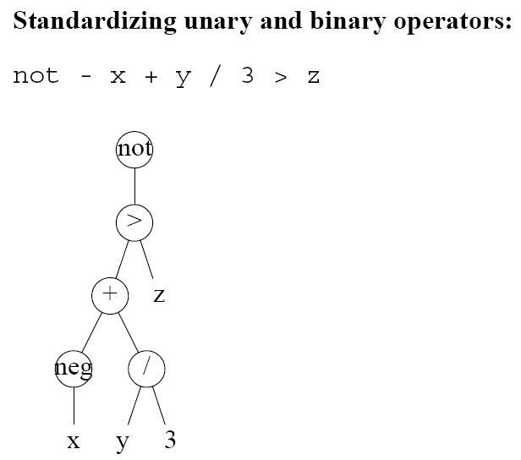

Slide 18
Standardizing the '@' Operator
See example
@ => gamma
/ | \ / \
E1 N E2 gamma E2
/ \
N E1

Slide 20
Standardizing Simultaneous Definitions
See example
and => =
| / \
=++ , tau
/ \ | |
X E X++ E++

Slide 22
Standardizing Simultaneous Definitions (cont’d)
lambda => lambda
/ \ / \
, E Temp ++gamma
| / \
X++i lambda gamma
/ \ / \
X.i .E Temp \
<INTEGER:i>

Slide 23
Standardizing the Conditional Operator
→ => gamma
/ | \ / \
B T F gamma nil
/ \
gamma lambda
/ \ / \
gamma lambda () F
/ \ / \
Cond B () T
Cond = fn B. fn T. fn F. B → T | F
Circular semantic definition !
Purpose of lambdas: delay evaluation until one option is discarded

Slide 24
Circular Semantic Definitions
K. Goedel's Incompleteness Theorem (1930's): Every logic system is either incomplete or inconsistent.
Incomplete is preferable to inconsistent.
Inevitable in semantics
English dictionary is useless to someone who understands no English.

Slide 25
Standardizing 'rec'
Will do later
rec => =
| / \
= X gamma
/ \ / \
X E Ystar lambda
/ \
X E

Slide 26
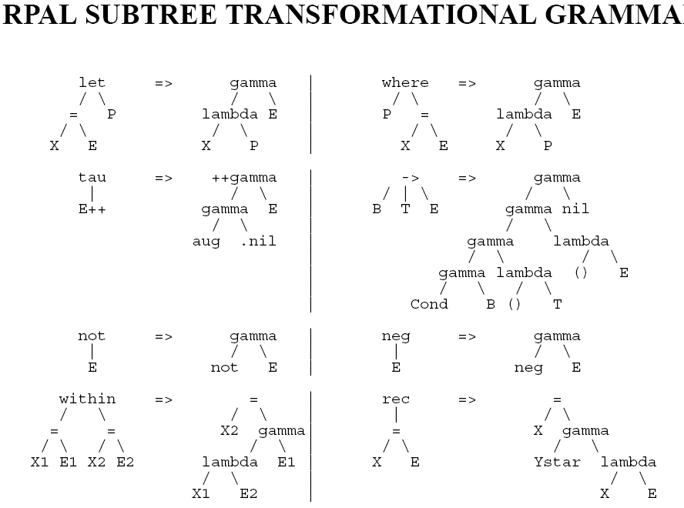

Slide 27
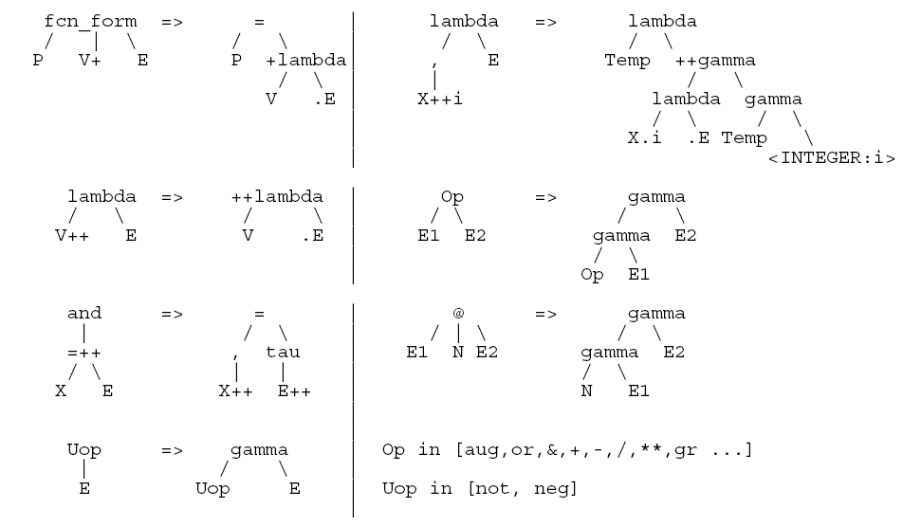

Slide 28
Summary
Transform AST into a standardized tree (ST).
ST is binary.
All internal nodes in the ST are either gamma or lambda.
It’s called “desugaring” the program: reducing it to two constructs: function abstraction/definition (lambda), and function application (gamma).

Slide 29
Thank You!

Slide 30
REFERENCES
Programming Language Pragmatics by Michael L. Scott. 3rd edition. Morgan Kaufmann Publishers. (April 2009).
Lecture Slides of Dr.Malaka Walpola and Dr.Bermudez

